Slide 1
Digital Naturalist Using IBM Watson Studio
CSE TEAM 32 :
Panyam Badrinath Reddy (19R11A05C9)

Slide 2
Contents :
->Introduction
->Explanation Of CNN
->FLASK
->Deployment using IBM Watson Studio

Slide 3
Introduction :
A naturalist is someone who studies the patterns of nature, identifies a different kind of flora and fauna in nature. Being able to identify the flora and fauna around us often leads to an interest in protecting wild spaces, and collecting and sharing information about the species we see on our travels is very useful for conservation groups like NCC.
When venturing into the woods, field naturalists usually rely on common approaches like always carrying a guidebook around everywhere or seeking help from experienced ornithologists. There should be a handy tool for them to capture, identify and share the beauty to the outside world.
Field naturalists can only use this web app from anywhere to identify the birds, flowers, mammals and other species they see on their hikes, canoe trips and other excursions.
In this project, we are creating a web application which uses a deep learning model, trained on different species of birds, flowers and mammals (2 subclasses in each for a quick understanding)and get the prediction of the bird when an image is been given.

Slide 4
Structure Of Dataset
Mammals:
->Elephant
->Rats
Flowers:
->Rose
->Sunflower
Birds:
->Eagle
->Parrot

Slide 5
Libraries Used:
from tensorflow.keras.models import Sequential
from tensorflow.keras.layers import Dense
from tensorflow.keras.layers import Convolution2D
from tensorflow.keras.layers import MaxPooling2D
from tensorflow.keras.layers import Flatten
from keras.preprocessing.image import ImageDataGenerator
from ibm_watson_machine_learning import APIClient

Slide 6
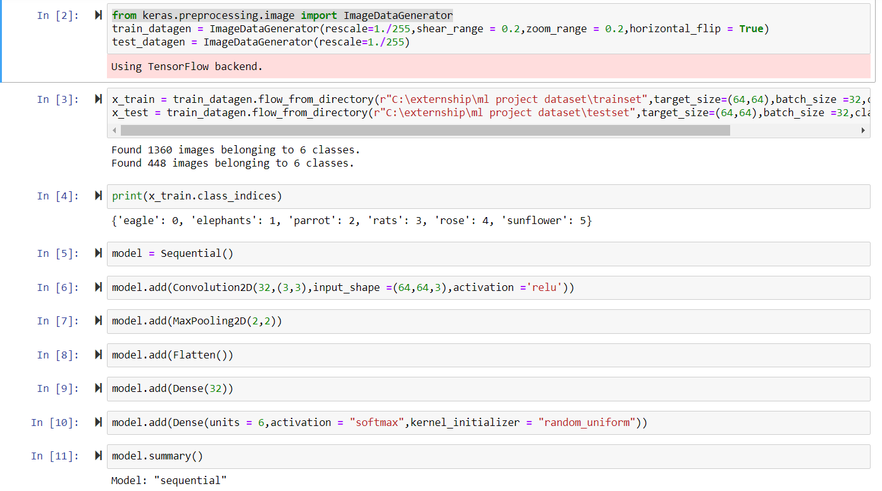
CNN

Slide 7
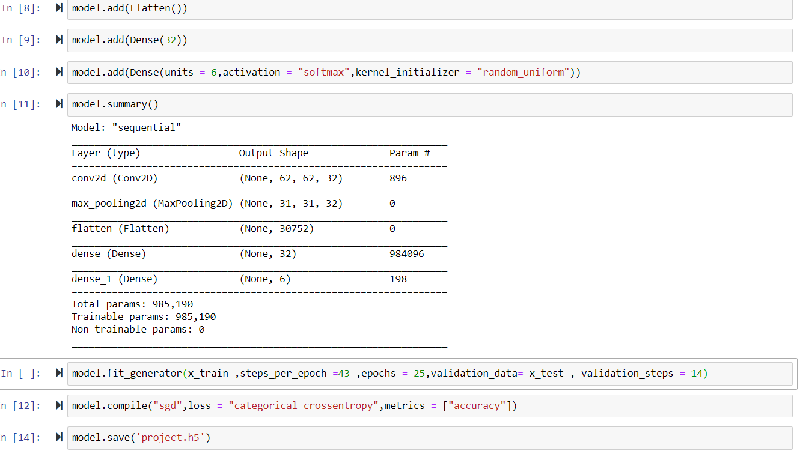

Slide 8
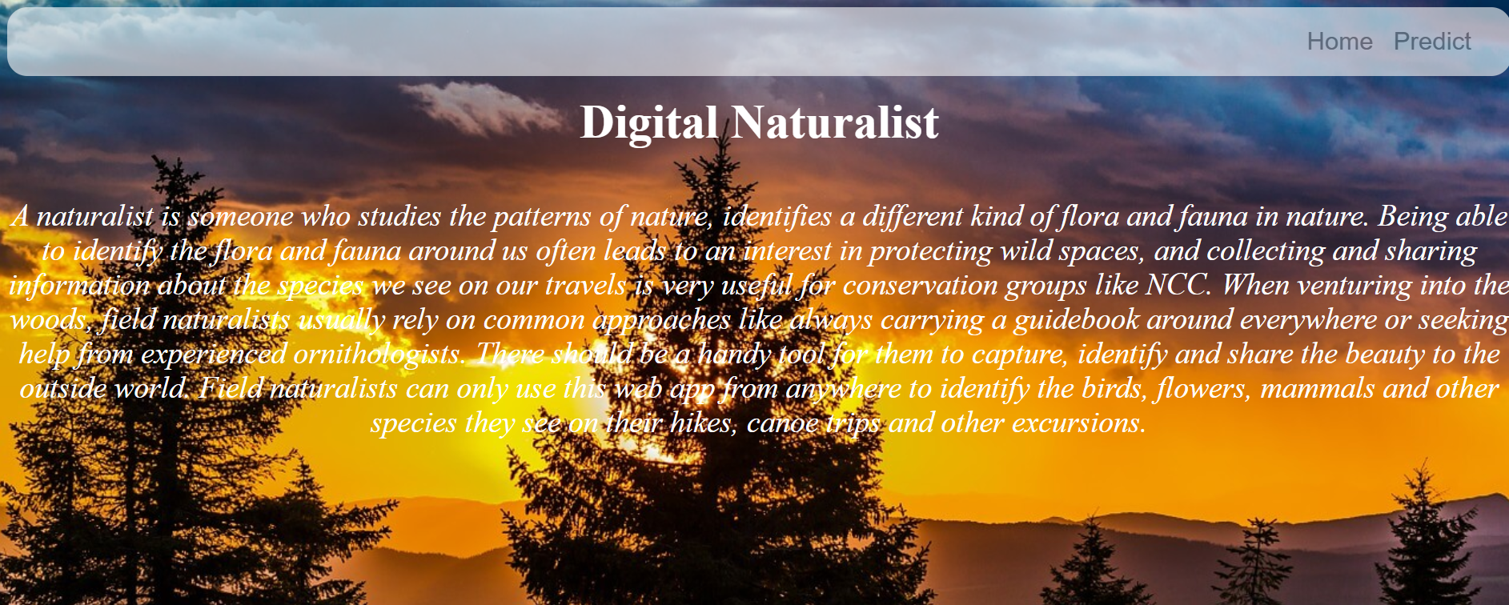
Website:

Slide 9
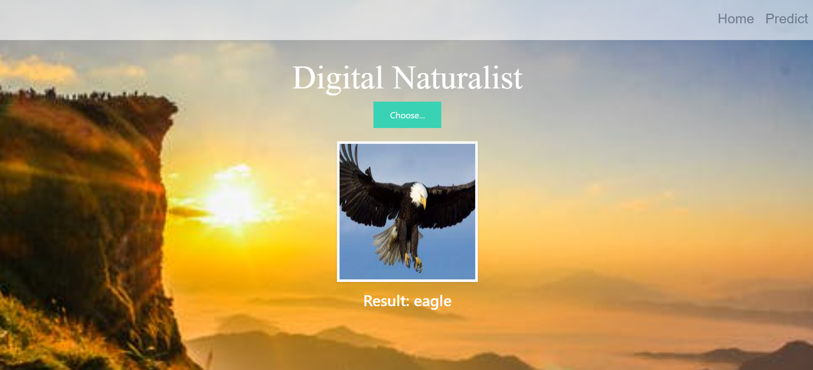
Prediction

Slide 10
THANK YOU

